Slide 1

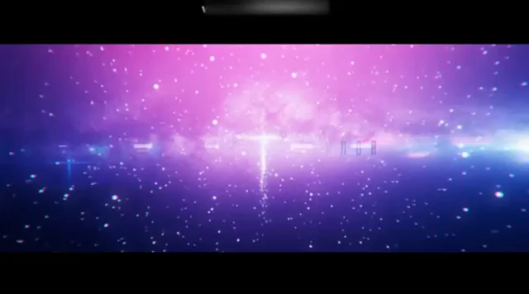

Slide 2
Team introduce
App description
Development Tools
Challenges
Project demo
Q & A

Slide 3

1
Team Members

Slide 4
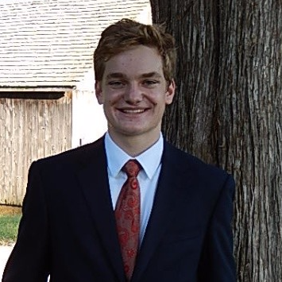
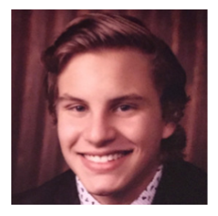
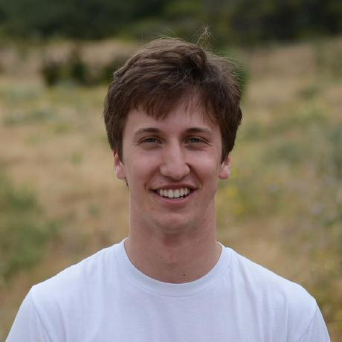
Team Members
Peter Martin
Robert Sarno
Max Macaluso
Integration layer
Integration layer
Frontend
· Connecting frontend and server.js.
· Connecting APIs of music application with our server.
· Connecting backend and server.js.
· Registration and login system.
· Music application link page.
· Music playlist apge

Slide 5
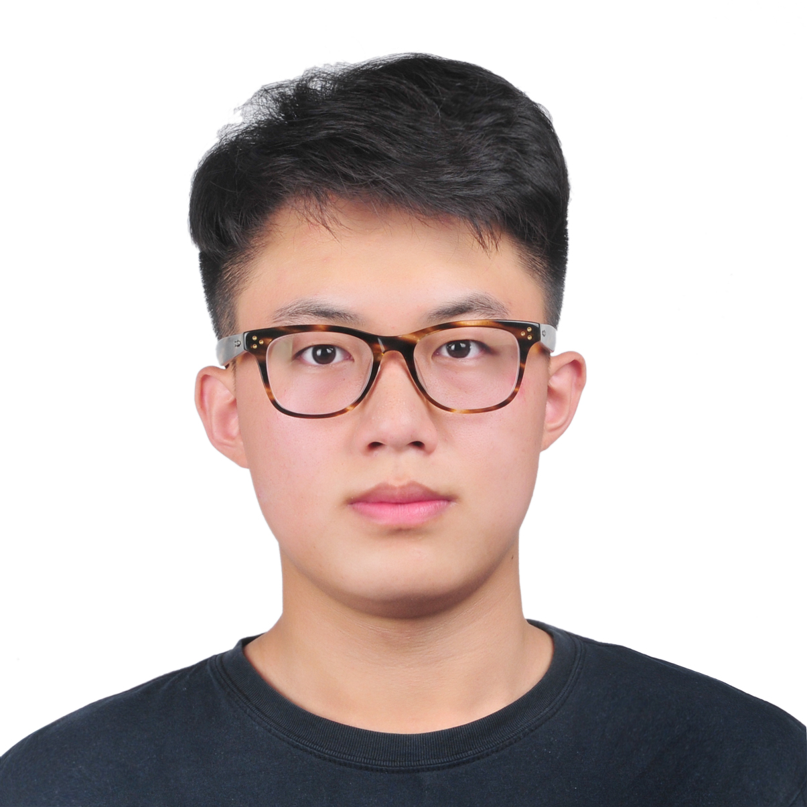
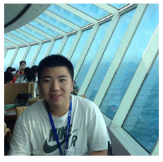
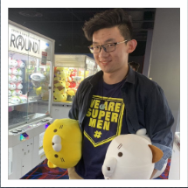
Team Members
Jiahao Wang
Zongyi Huang
Keyu Wu
Frontend
Backend
Backend
· User login and sign up page.
· Music playlist page
· Database design
· Presentation
PowerPoint
· Creating database
· Helping other
groupmembers.

Slide 6
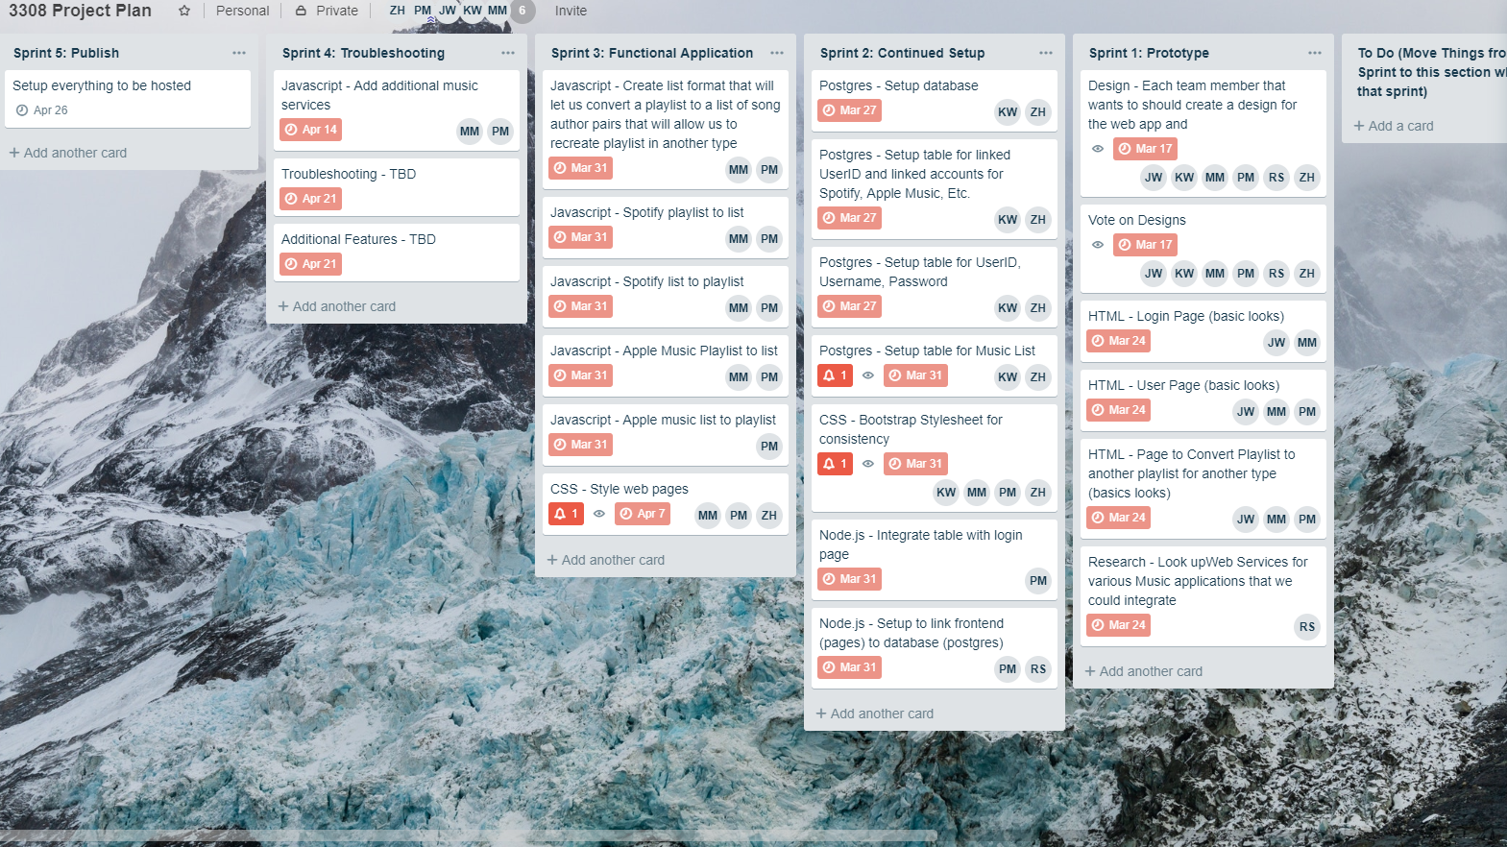
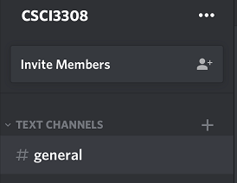
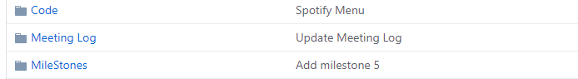
Project management
· Project Plan: Trello
· Communication Tool: Discord
· Document Share Tool: Github
· Meeting time:
—A brief talk after recitation
—Meet every Tuesday at CSEL
—Substitution : Saturday at CSEL

Slide 7
2
App description

Slide 8











Getting your all music in a platform
Design for the everyday music user.
Give you a platform to play all music you like.
Music platforms

Slide 9
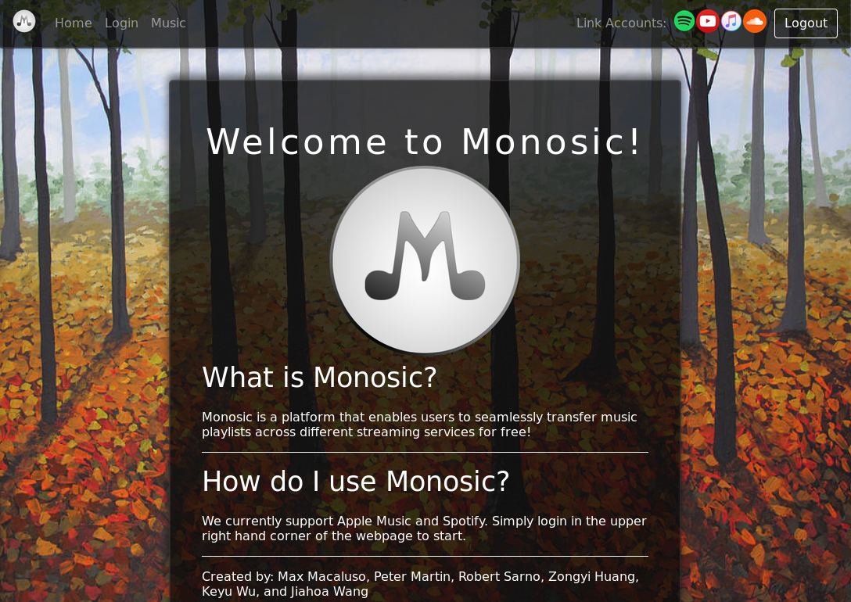

Slide 10
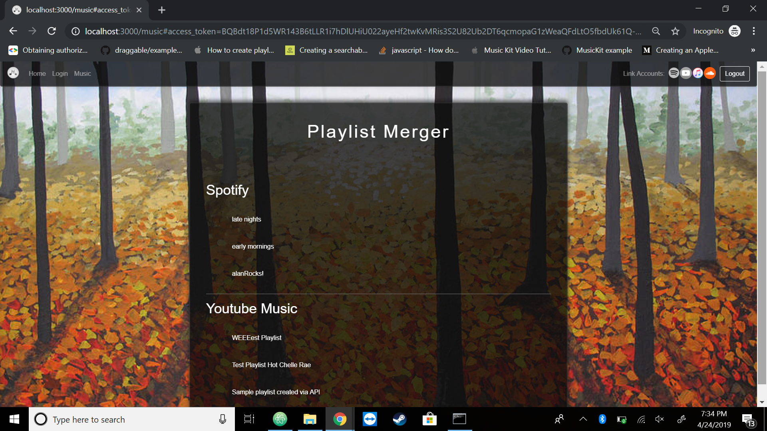

Slide 11
3
Development Tools

Slide 12
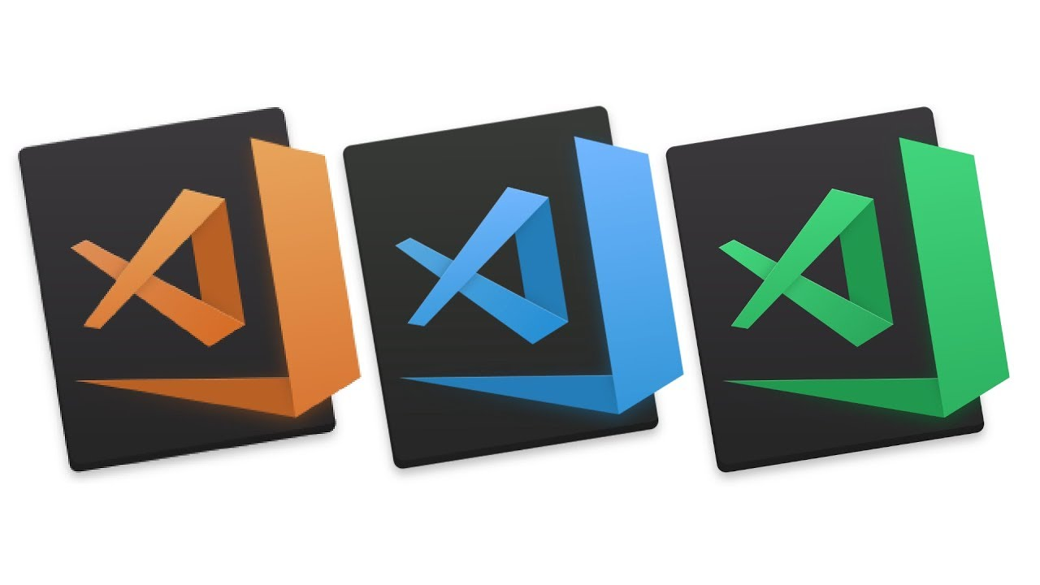







Frontend
Integration layer
Backend
HTML, Style list, .json file
server.js, API to music applications
User information

Slide 13
4
Challenges

Slide 14

Challenge 1: API
- Given the time constraints, we had to decide which APIs to implement.
Challenge 2: GitHub
- Team Git Collaboration
Challenge 3: Time Management
- Hard to manage time with other courses.

Slide 15
5
Project Demo

Slide 16
6
Q & A

Slide 17
Thanks for watching

